Slide 1


Group Members
01
Asjad Ullah (UET-31)
FINAL YEAR PROJECT
NEWS MAVENS
02
Usama Shafique (UET-40)
Freelance Platform for Journalists
03
Rameen Naveed (UET-42)
Supervised By
Engr. Fahim Muhammad Khan

Slide 2

Contents
Introduction/Problem Statement
Aim and Objectives/Scope
Methodology/diagrams
Proposed time schedule
Work done so far
References

Slide 3

Introduction
News Mavens will be the first platform for everyone to keep them self up to date about daily news reports.
Our platform will provide remote work for journalists as many big companies or media houses can hire them on remote basis work (small projects, contract basis).

Slide 4
Problem Statement
Job security is one of the most challenging aspects of being a journalist nowadays.
People nowadays rely on social media news that isn't authenticated and doesn't have a reliable source.
Media houses can't find the right person because of the market gap.
Many News agency requires journalist for single project but they have to hire them as there isn’t a proper channel for hiring journalist for single project remotely or on- site

Slide 5
Aim
To facilitate journalists, viewer's and media houses to see/post updated jobs/news.
Objectives
To help journalist community to provide freelance remote work opportunities and reduce job insecurity.
To help media houses, new channels and online newspapers companies to find the best journalist they need.
Help to keep everyone up to date with daily news about news reports by providing an authentic and resourceful news

Slide 6
Proposed Methodology
Agile Methodology:
We are using agile methodology because our project is open-ended. It will require changes on a daily or maybe weekly basis so for that reason we prefer agile methodology
We have concluded that XP agile framework is most suitable for our project from time perspective. Following are other main aspects of XP;
Cost effective
Simplicity
High visibility
Feedback

Slide 7
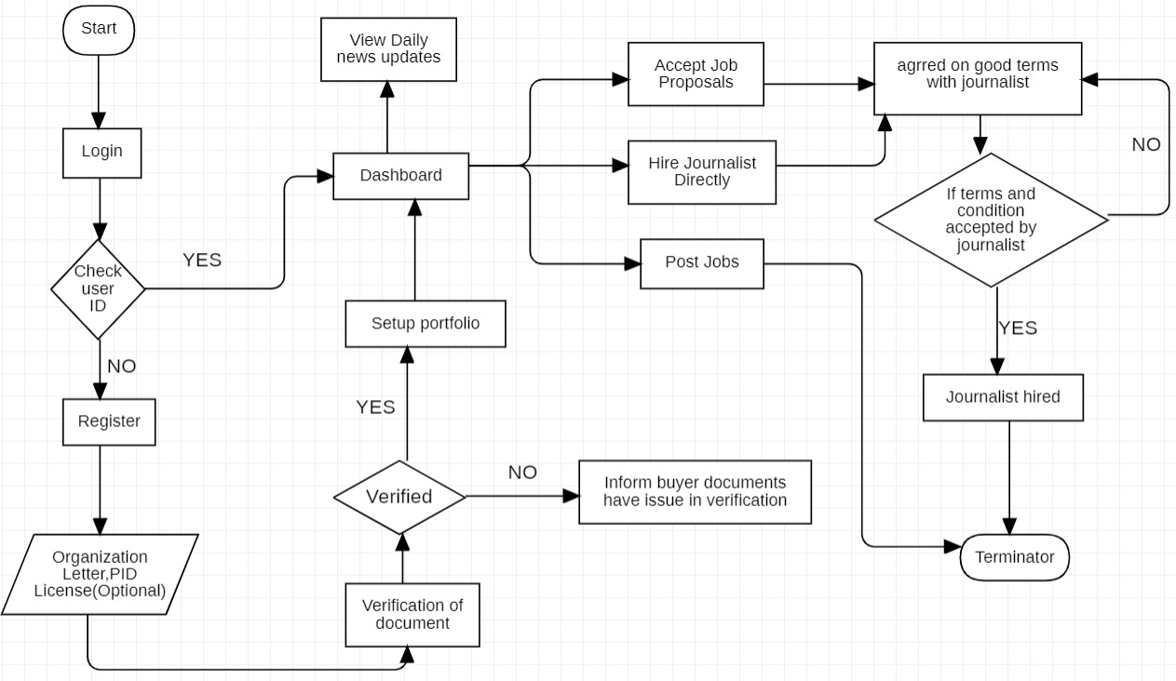
Flow Diagram
Buyer Flow diagram

Slide 8
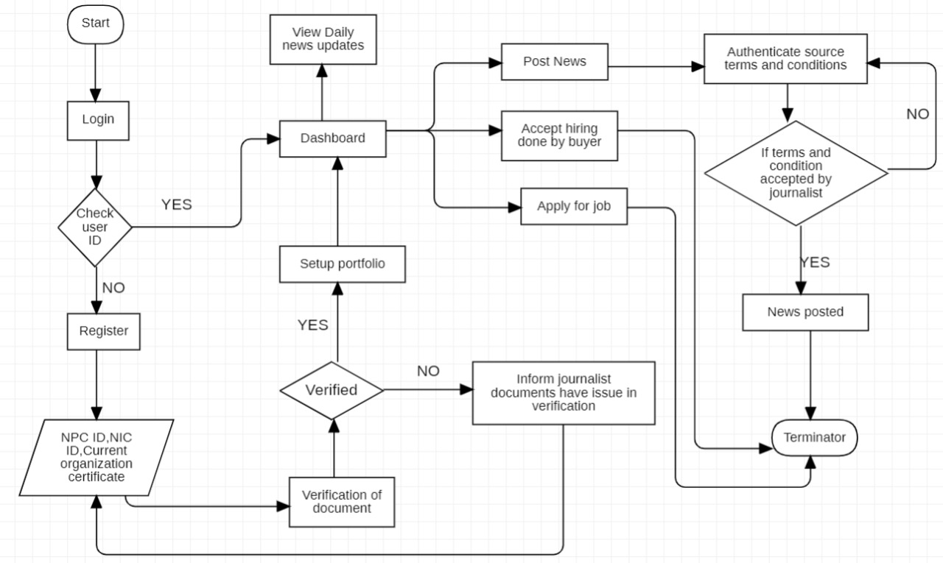
Journalist Flow diagram

Slide 9
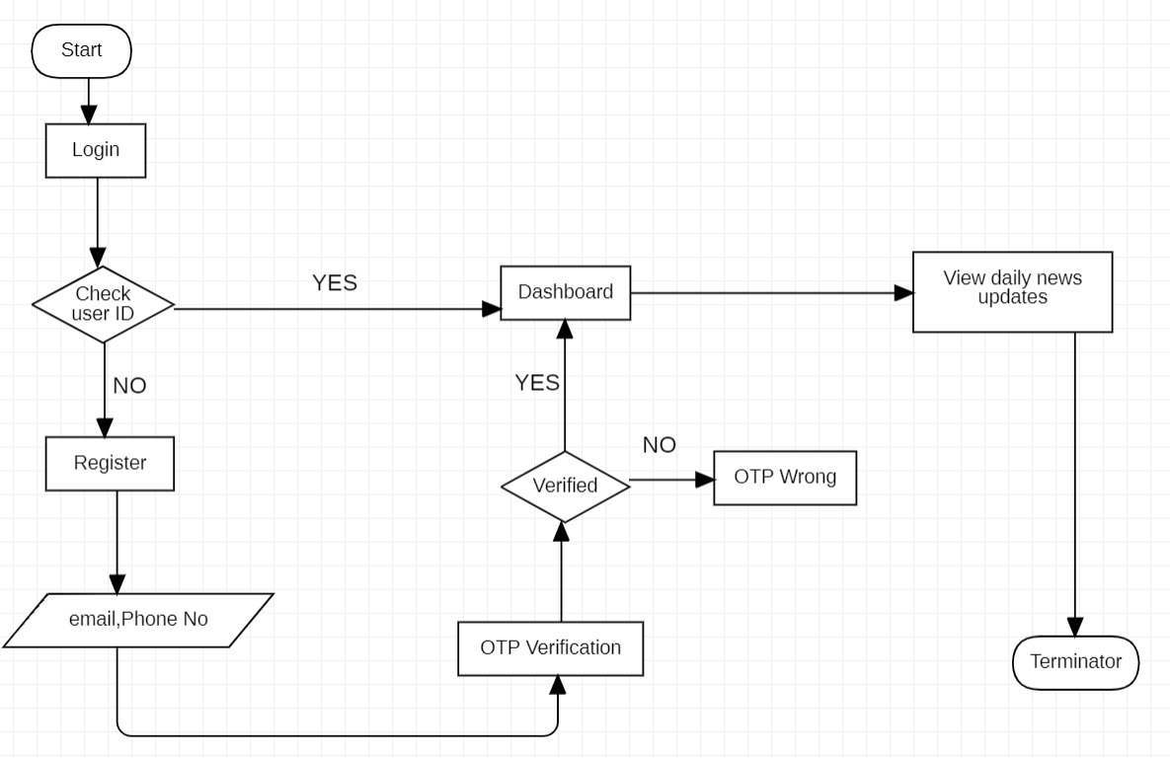
Viewer Flow diagram

Slide 10
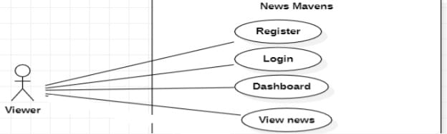
Use-case Diagrams:
use case diagram of viewer

Slide 11
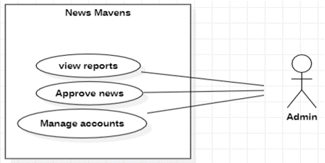
use case diagram of Admin

Slide 12
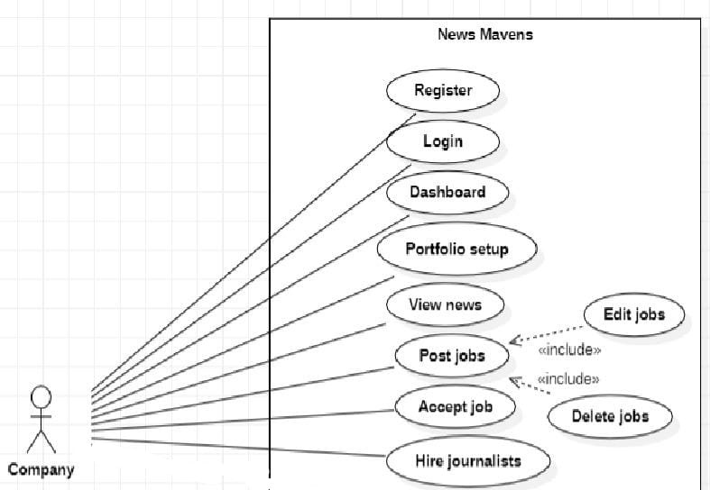
use case diagram of company

Slide 13
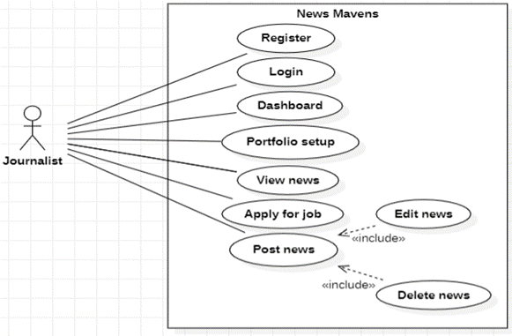
use case diagram of journalist

Slide 14
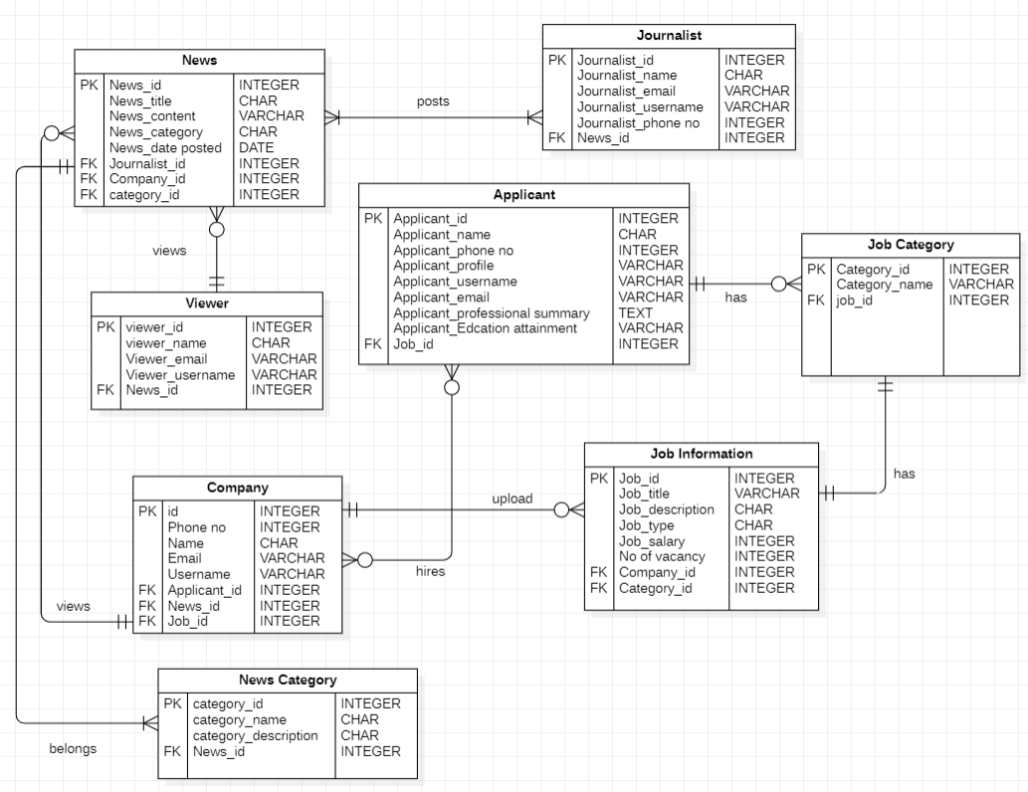
ER- Diagram:

Slide 15
Proposed Work Schedule:
One Month | One Month
Study of Literature | Two Weeks
Analysisof Proposed Scheme | One Month
Preparation of Scheme/Model | One Month
Implementation of Scheme/Model | One Month
Analysis and Simulation | One Month
Result Formulation | Two Weeks
Final Write-up & Thesis Submission | Two Weeks

Slide 16
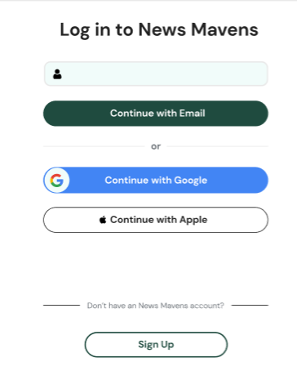
Work done so far:
Login Page:

Slide 17
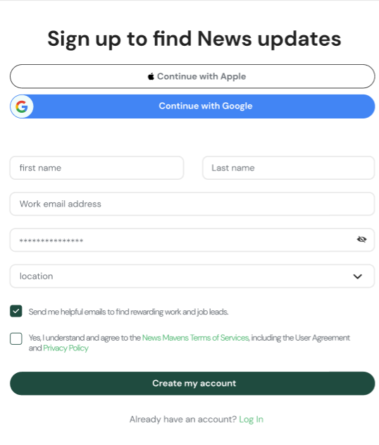
Register Page:

Slide 18
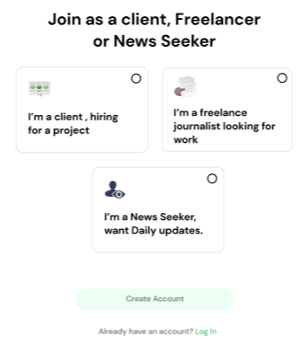
Dashboard Page:

Slide 19
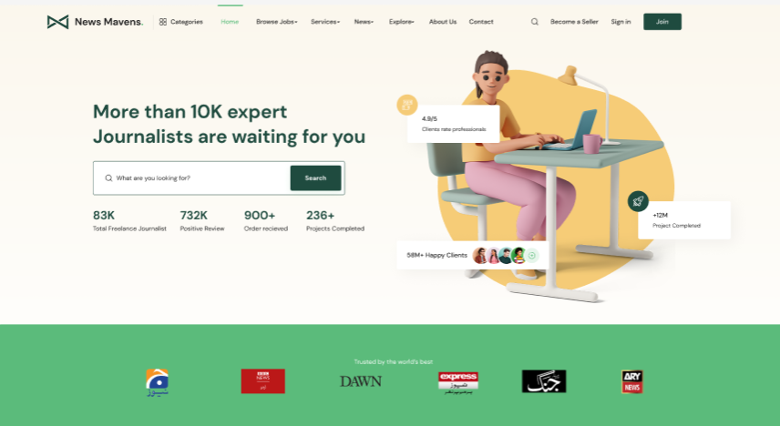
Home Page:

Slide 20
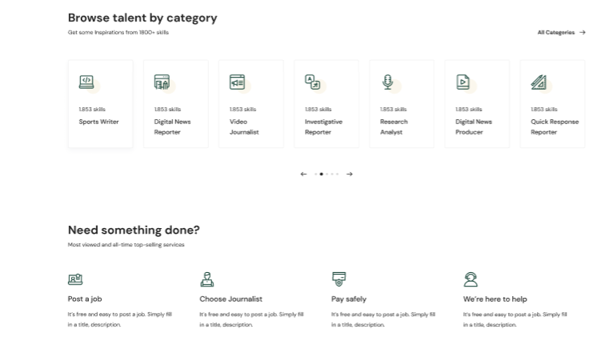
Home Page:

Slide 21
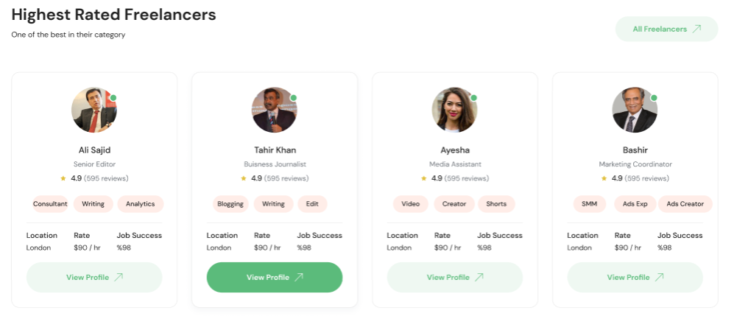
Home Page:

Slide 22
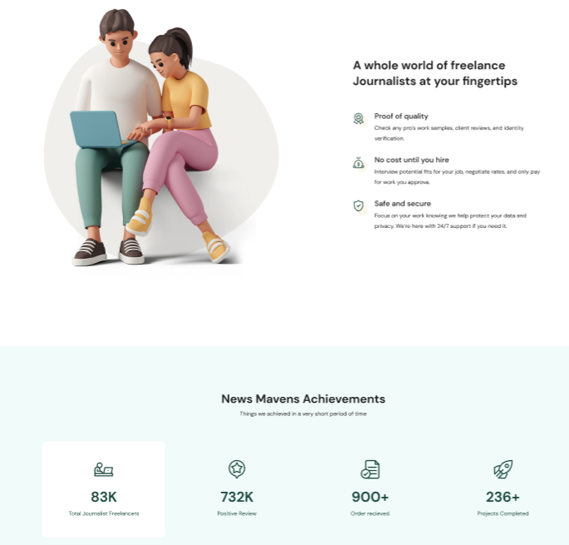
Home Page:

Slide 23

Home Page:

Slide 24
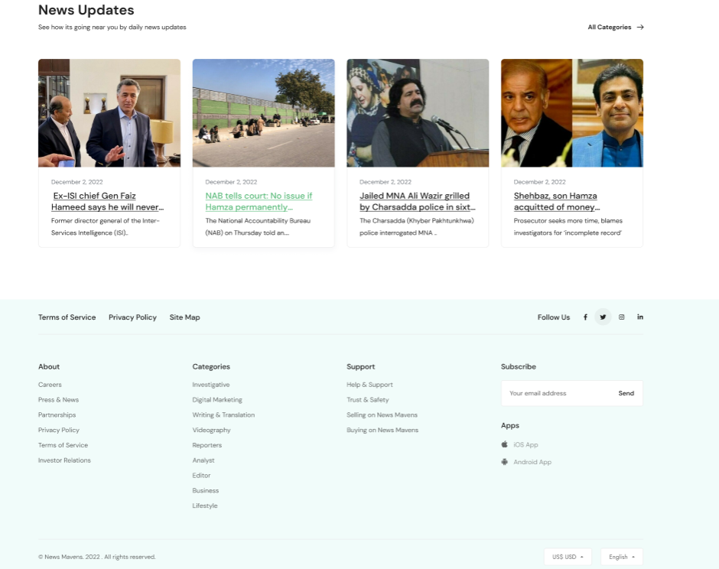
Home Page:

Slide 25
References
Westland, O. (2013). Mobile news: A review and model of journalism in an age of mobile media. Digital journalism, 1(1), 6-26.
Sotiropoulos, E., Vryzas, N., Vrysis, L., Avraam, E., & Dimoulas, C. (2019). Growing media skills and know-how in situ: Technology-enhanced practices and collaborative support in mobile news-reporting. Education Sciences, 9(3), 173.
Vandenbroucke, K., Baccarne, B., & Schuurman, D. (2014). Connecting with citizen journalists: an exploratory Living lab study on motivations for using mobile reporting applications. In Etmaal van de communicatiewetenschappen, Proceedings. Wageningen, The Netherlands.

Slide 26
Ashraf, A., Tayyib, M., Awais, M., & Ali, F. (2020). Effects of job insecurity on media professionals of Pakistan. Journal of Organizational Culture, Communications and Conflict, 24, 1-15.
Westland, O. (2013). Mobile news: A review and model of journalism in an age of mobile media. Digital journalism, 1(1), 6-26. 3.
Alcott, H., & Gentzkow, M. (2017). Social media and fake news in the 2016 election. Journal of economic perspectives, 31(2), 211-36.

Slide 27
Q & A

Slide 28
Thank You

